Slide 1




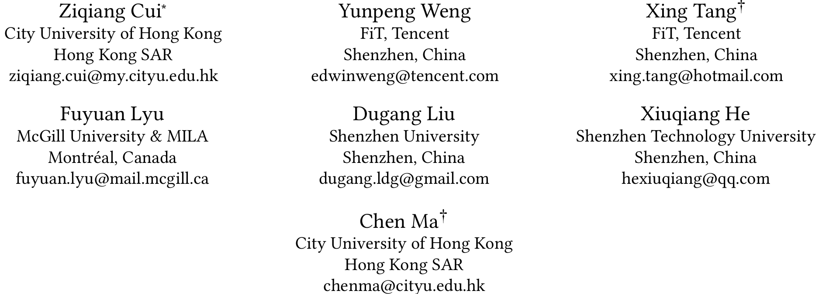



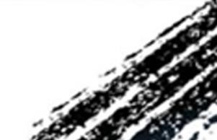

ATAI
Advanced Techniqueof Artificial Intelligence
ATAI
ChongqingUniversity _{AdvancedTechniqueof}
of Technology Artificial Intelligence
Chongqing University of
Technology
Chongqing University ^{ATAI}
_{of Technology} Advanced Techniqueof
Artificial Intelligence
Chongqing University of Technology
Chongqing University of Technology
Comprehending Knowledge Graphs with Large Language Models
for Recommender Systems
Code: https://github.com/ziqiangcui/CoLaKG
2025.11.3•ChongQing
—— SIGIR 2025
Reported by Shunan Yin
1
Notes:
用大模型理解知识图谱用于推荐系统

Slide 2

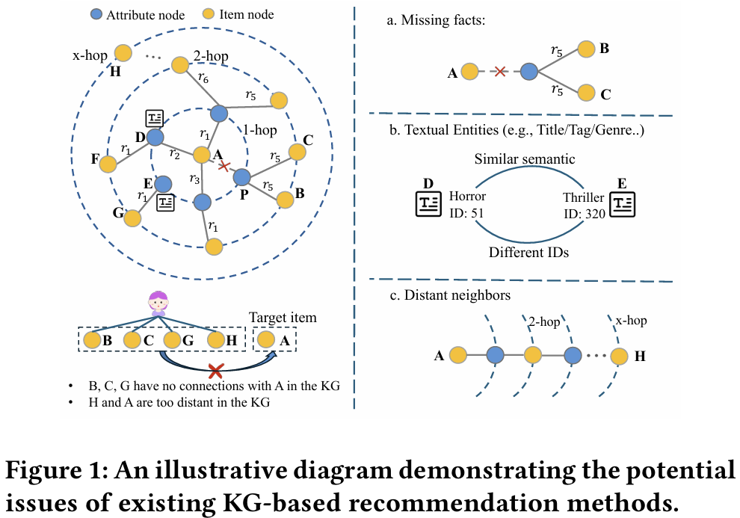
ATAI
AdvancedTechniqueof
Artificial Intelligence
ATAI
ChongqingUniversity _{AdvancedTechniqueof}
of Technology Artificial Intelligence
ChongqingUniversity of Technology
Motivation
1)Many KGs suffer from missing facts and limited scopes, as constructing KGs requires manual effort and domain expertise.
2)Existing methods convert textual entities and relations into IDs for use, which can result in losing natural semantic connections between items.
3)Existing methods struggle to capture high-order relationships in the entire KG.
Notes:
1.缺少关键属性，例如电影的类型，可能会导致共享相同属性的项目失去联系
2.现有的方法将文本实体和关系转换为ID以供使用，这可能导致失去项之间的自然语义联系。例如，在图1中，“恐怖片”和“惊悚片”分别是F项和G项的两个语义相关的属性。然而，相似的语义没有反映在不同的实体ID(51和320)中，这进一步导致相关项F和G在KG中没有连接
3.现有的方法很难捕捉整个KG中的高阶关系。大多数通过堆叠多层图神经网络(GNN)来传播和聚集信息，逐层传播不仅效率低下，而且会积累大量不相关的节点信息，导致过平滑问题
如图1左下角所示，由于上述三个限制，现有方法无法确定相互过的物品与目标物品之间的潜在联系，从而导致不太理想的建议。

Slide 3

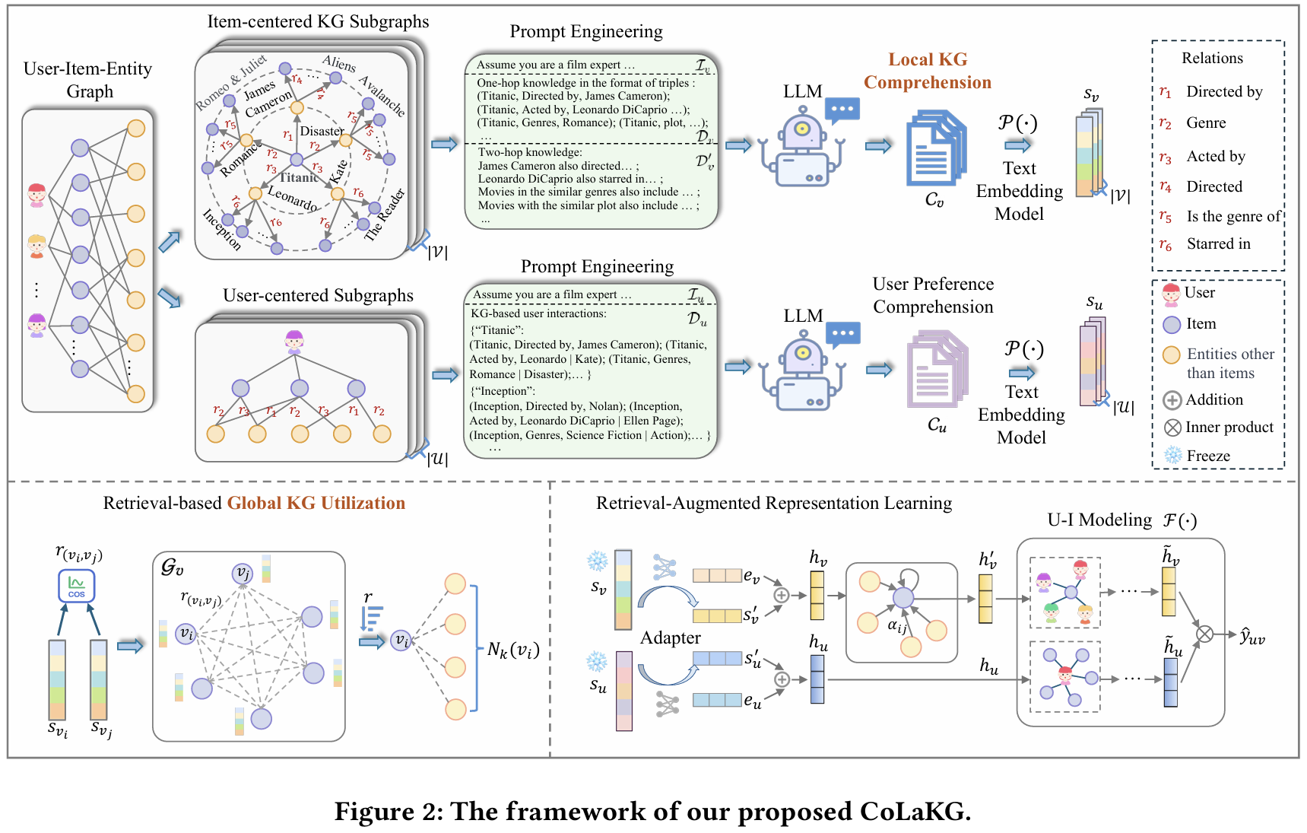
ChongqingUniversity of Technology
ATAI
AdvancedTechniqueof
Artificial Intelligence
ATAI
ChongqingUniversity _{AdvancedTechniqueof}
of Technology Artificial Intelligence
Overview

Slide 4
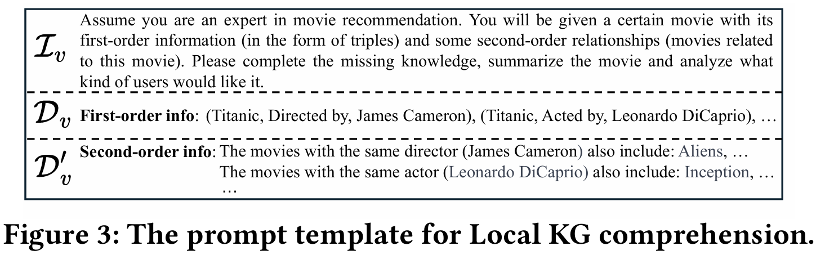
ChongqingUniversity of Technology
ATAI
AdvancedTechniqueof
Artificial Intelligence
ATAI
ChongqingUniversity _{AdvancedTechniqueof}
of Technology Artificial Intelligence
Overview

Slide 5

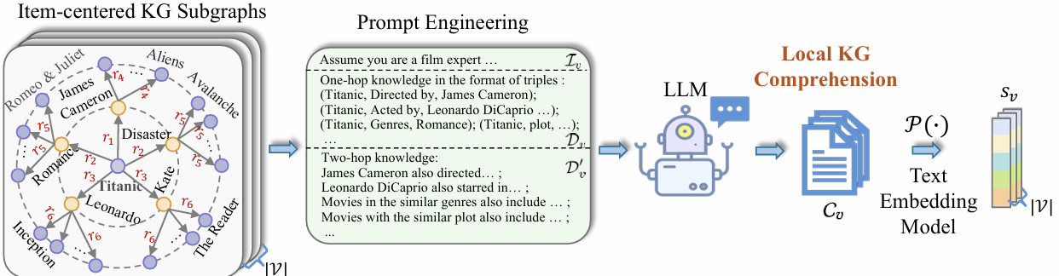
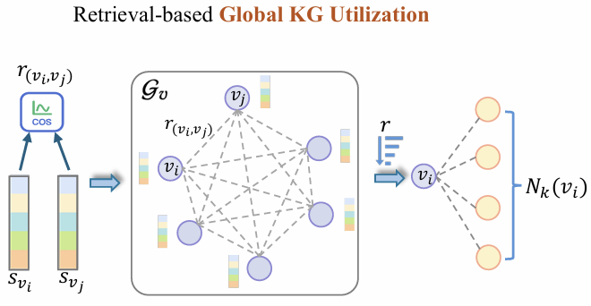
ChongqingUniversity of Technology
Method
ATAI
AdvancedTechniqueof
Artificial Intelligence
ATAI
ChongqingUniversity _{AdvancedTechniqueof}
of Technology Artificial Intelligence

Slide 6
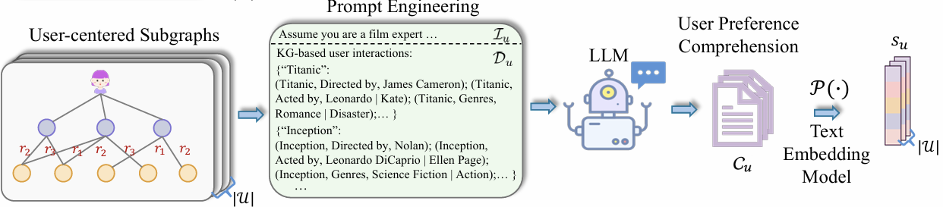
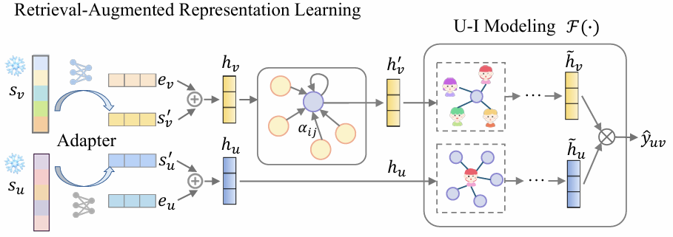


ChongqingUniversity of Technology
Method
ATAI
AdvancedTechniqueof
Artificial Intelligence
ATAI
ChongqingUniversity _{AdvancedTechniqueof}
of Technology Artificial Intelligence

Slide 7
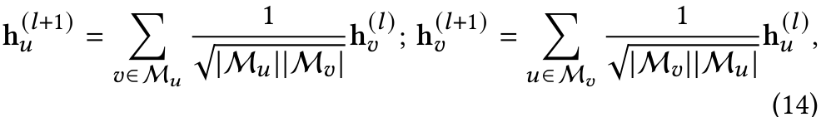
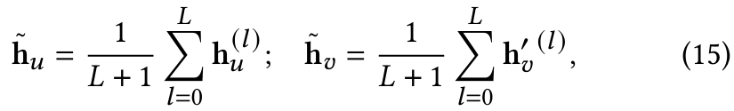
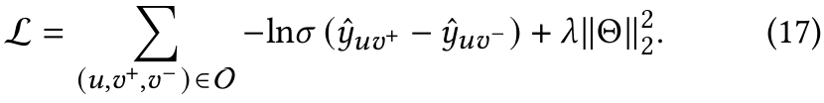
ChongqingUniversity of Technology
Method
ATAI
AdvancedTechniqueof
Artificial Intelligence
ATAI
ChongqingUniversity _{AdvancedTechniqueof}
of Technology Artificial Intelligence

Slide 8

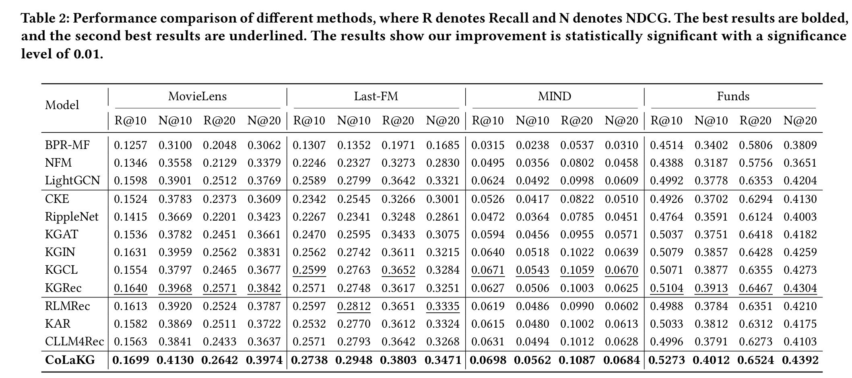
Experiments
ATAI
AdvancedTechniqueof
Artificial Intelligence
ATAI
ChongqingUniversity _{AdvancedTechniqueof}
of Technology Artificial Intelligence
ChongqingUniversity of Technology

Slide 9
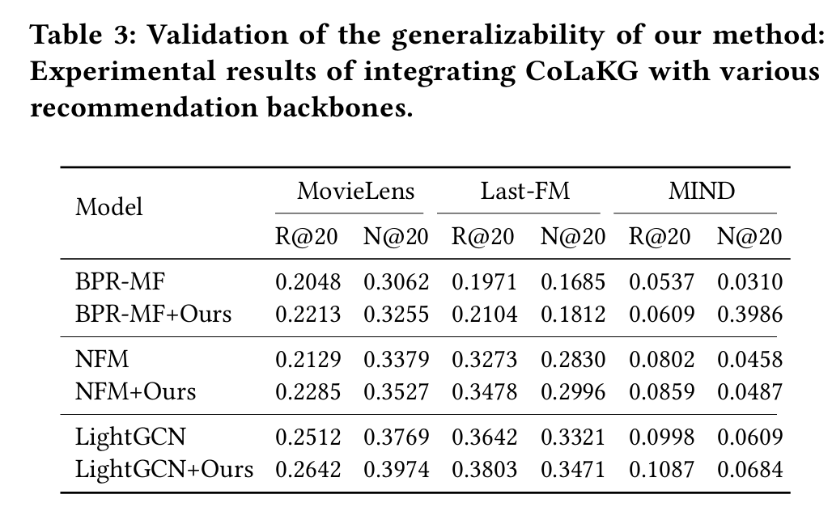
Experiments
ATAI
AdvancedTechniqueof
Artificial Intelligence
ATAI
ChongqingUniversity _{AdvancedTechniqueof}
of Technology Artificial Intelligence
ChongqingUniversity of Technology

Slide 10
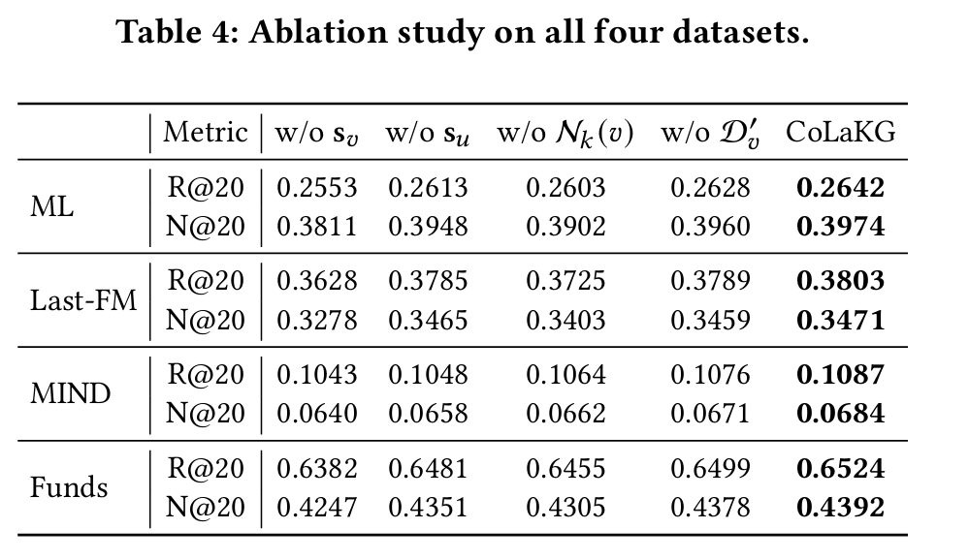
ATAI
AdvancedTechniqueof
Artificial Intelligence
ATAI
ChongqingUniversity _{AdvancedTechniqueof}
of Technology Artificial Intelligence
ChongqingUniversity of Technology
Experiments

Slide 11
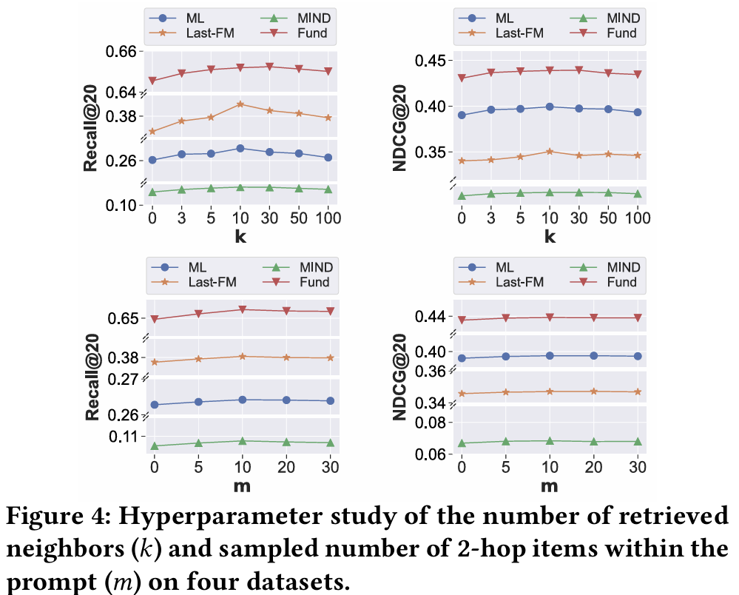
ATAI
AdvancedTechniqueof
Artificial Intelligence
ATAI
ChongqingUniversity _{AdvancedTechniqueof}
of Technology Artificial Intelligence
ChongqingUniversity of Technology
Experiments

Slide 12
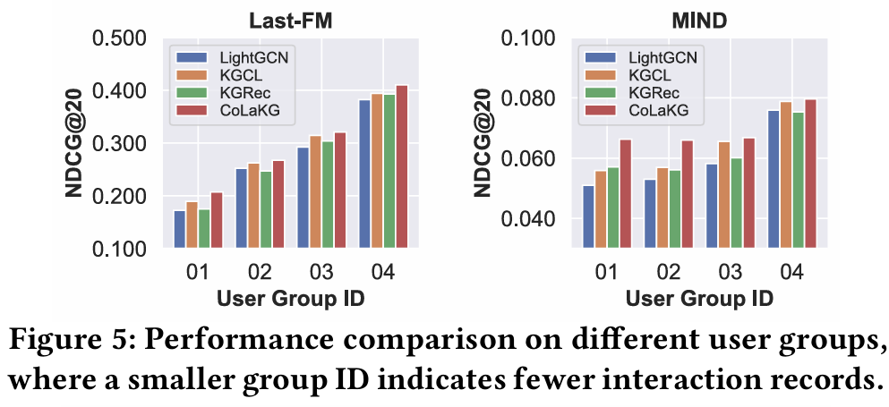
ATAI
AdvancedTechniqueof
Artificial Intelligence
ATAI
ChongqingUniversity _{AdvancedTechniqueof}
of Technology Artificial Intelligence
ChongqingUniversity of Technology
Experiments

Slide 13
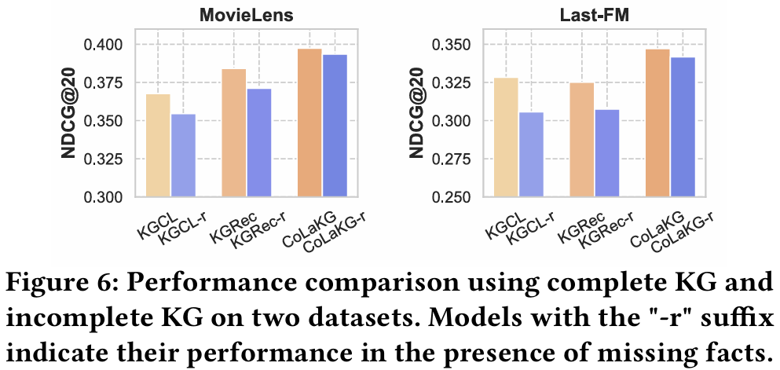
ATAI
AdvancedTechniqueof
Artificial Intelligence
ATAI
ChongqingUniversity _{AdvancedTechniqueof}
of Technology Artificial Intelligence
ChongqingUniversity of Technology
Experiments

Slide 14
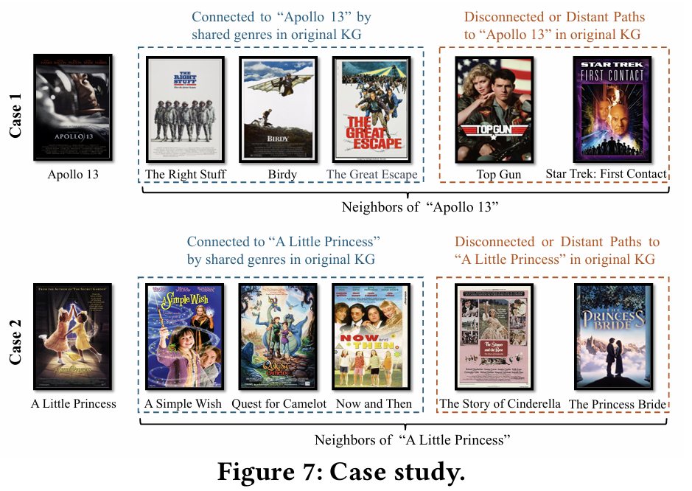
ATAI
AdvancedTechniqueof
Artificial Intelligence
ATAI
ChongqingUniversity _{AdvancedTechniqueof}
of Technology Artificial Intelligence
ChongqingUniversity of Technology
Experiments

Slide 15


ChongqingUniversity of Technology
ATAI
AdvancedTechniqueof
Artificial Intelligence
ATAI
ChongqingUniversity _{AdvancedTechniqueof}
of Technology Artificial Intelligence
Thanks!

